Slide 1

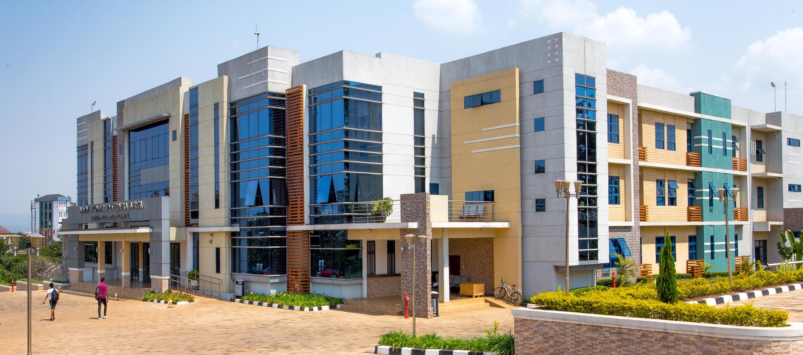
12th September, 2025
INSY 8311 Database Development with PL/SQL

Slide 2
Understanding Joins
Joins are used to retrieve data from multiple tables based on related columns.
Common relationships: EMPLOYEES → DEPARTMENTS via department_id
Types of joins: INNER, LEFT OUTER, RIGHT OUTER, FULL OUTER

Slide 3
INNER JOIN
Returns only rows where there is a match in both tables.
Rows without a match on either side are excluded
Example:
SELECT e.first_name, d.department_name
FROM employees e
JOIN departments d ON e.department_id = d.department_id;

Slide 4
LEFT OUTER JOIN
Returns all rows from the left table
If there is a match in the right table, include it.
If no match, right-side columns = NULL
Example:
SELECT e.first_name, d.department_name
FROM employees e
LEFT JOIN departments d ON e.department_id = d.department_id;

Slide 5
RIGHT OUTER JOIN
Returns all rows from the right table.
If there is a match in the left table, include it.
If no match, left-side columns=Null
Example:
SELECT e.first_name, d.department_name
FROM employees e
RIGHT JOIN departments d ON e.department_id = d.department_id;

Slide 6
FULL OUTER JOIN
Returns all rows from both tables.
Matches where possible.
If no match, fill missing side NULL.
Example:
SELECT e.first_name, d.department_name
FROM employees e
FULL OUTER JOIN departments d ON e.department_id = d.department_id;

Slide 7
SELF JOIN
A table is joined with itself.
Compare rows within the same table, like employee vs manager
Example:
SELECT e.first_name AS Employee, m.first_name AS Manager
FROM employees e
JOIN employees m ON e.manager_id = m.employee_id;

Slide 8
Cross Join
Returns the Cartesian product → every row from table A combined with every row from table B.
Rarely used unless intentional.
Example:
SELECT e.first_name, d.department_name
FROM employees e
CROSS JOIN departments d;

